Slide 1

CPRG 210 Web Application Development
Module 7: More JS Features

Slide 2
Outlines
Introduction to JQuery
Cookies
Timers
JSON Overview
Dynamic HTML
DOM Navigation

Slide 3
Introduction to JQuery
Free and Open Source JS Library
JQuery
It is a JS script (Written in JS)
Making Website more Interactive and Dynamic
Select/Find HTML Elements
Manipulate the Selected HTML Elements
JQuery
Traversing DOM & Manipulating its Elements
Event Handling & CSS Manipulation
Much More
Notes:
The continue statement will break the current loop and continue with the next value.
When I = 4, the rest of the loop will not be executed and will move to the next iteration (I = 5)

Slide 4
Why JQuery?
Write Less and Do More → Rapid Development
Well Documented & Supported
Popular & Easy to Learn
Compatible with All Browsers
Hide divs with pure JavaScript
divs = document.getElementByTagName(‘div’); for (i = 0; i < divs.length; i++) { divs[i].style.display = ‘none’; }
Hide divs with jQuery
$(“div”).hide();
Notes:
The continue statement will break the current loop and continue with the next value.
When I = 4, the rest of the loop will not be executed and will move to the next iteration (I = 5)

Slide 5
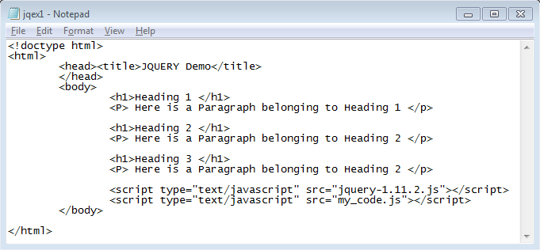
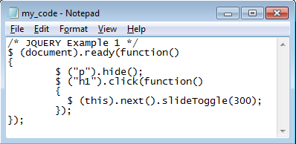
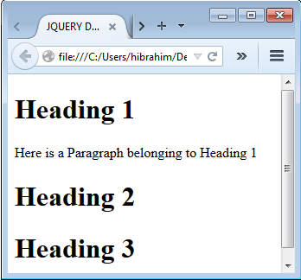
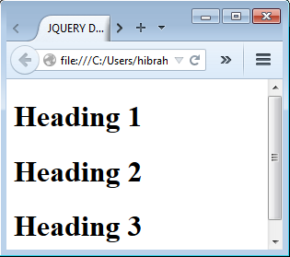
Adding JQuery to Web Pages
$(document).ready(function(){
// jQuery methods go here...
});
Notes:
The continue statement will break the current loop and continue with the next value.
When I = 4, the rest of the loop will not be executed and will move to the next iteration (I = 5)

Slide 6
JQuery Syntax
$(selector).action()
$: Access jQuery
Selector: ID, Class, Tag Name → Finding HTML Elements
action(): Things Performed on Selected HTML Element(s)
Examples
$("p").hide() - hides all <p> elements.
$(".test").hide() - hides all elements with class="test".
$("#test").hide() - hides the element with id="test".
$(this).hide() - hides the current element.
Notes:
The continue statement will break the current loop and continue with the next value.
When I = 4, the rest of the loop will not be executed and will move to the next iteration (I = 5)

Slide 7










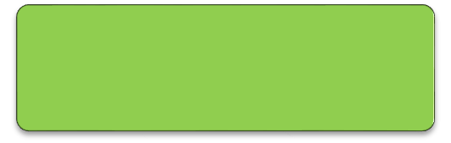
Basic Selectors
Tag Name: $("tagName") → $("div"), $("p"), $("div")
Tag ID: $("#id") → $("#name"), $("#address")
Tag Class: $(".className") → $(".comment"), $(".code")
Selecting All HTML Elements → $("*")
$("p")
<p>
$("div")
<div>
$("#foo")
id="foo"
$(".foo")
class="foo"
Notes:
The continue statement will break the current loop and continue with the next value.
When I = 4, the rest of the loop will not be executed and will move to the next iteration (I = 5)

Slide 8
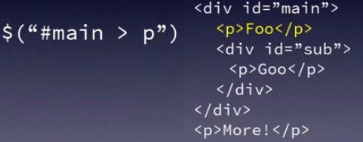
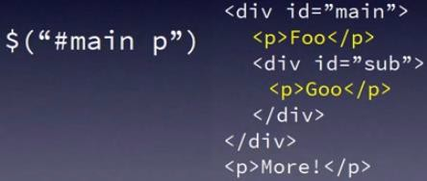
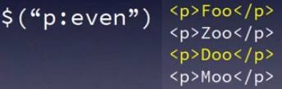
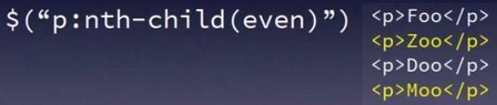
Combined Selectors
$("tagName.className") → $("h1.mainTitle")
$("tagName.className#tagId") →
$("h1.mainTitle#firstHeading")
selects all elements that are the nth child | nth-child(n|even|odd|formula)
Notes:
The continue statement will break the current loop and continue with the next value.
When I = 4, the rest of the loop will not be executed and will move to the next iteration (I = 5)

Slide 9
Cookies
Small data files stored in client/user computers
A way to store information about users and their preferences
Cookie is associated with domain name (i.e. website)
When domain is revisited, cookies belonging to this domain will be retrieved by browser and sent to the server.
Issues
No guarantee that user will use same computer.
Browser may have cookies turned off (i.e. disabled).
User may delete cookies.
Essentially no control.
Notes:
Cookies are data, stored in small text files, on your computer.
When a web server has sent a web page to a browser, the connection is shut down, and the server forgets everything about the user.
Cookies were invented to solve the problem "how to remember information about the user":
When a user visits a web page, his name can be stored in a cookie.
Next time the user visits the page, the cookie "remembers" his name.
When a browser requests a web page from a server, cookies belonging to the page is added to the request. This way the server gets the necessary data to "remember" information about users.

Slide 10
Cookies
Saved in Name-Value Pairs Separated by ;
expires: Determine Expiry Date – By Default, the Cookie is Deleted when the Browser is Closed
Structure
Domain: Domain-Name
Path: What Path the Cookie Belongs to – Default: Current Page, “/” for All pages in the Website
Secure: Cookie to only be Transmitted Over Secure Protocol as https
name=value; expires=date; path=directory; domain=domain-name; secure
document.cookie = “color=blue; expires=Thu, 18 Dec 2018 12:00:00 UTC; path=/";
Notes:
Object is a container for data and the logic that is needed to maintain the data.
Objects correspond to actual things that people use in their work.
Methods correspond to actual tasks that are done to store and maintain data used in the work.

Slide 11
Cookies Manipulation
Operation | Description
Creating | Assign a value to document.cookie Set expires to a future date
Accessing/Retrieving | Read document.cookie
Updating | Similar to Creation
Deleting | Set expiry date to current or passed date/time.
// Deletion
document.cookie = "username=; expires=Thu, 01 Jan 1970 00:00:00 UTC; path=/;";
JavaScript cookie basics 2.html
JavaScript cookie basics 3.html
Notes:
Object is a container for data and the logic that is needed to maintain the data.
Objects correspond to actual things that people use in their work.
Methods correspond to actual tasks that are done to store and maintain data used in the work.

Slide 12
Timers
Timerexample.html
Running JS Code After Specified Time
Window Object Has 2 Methods (setTimeout() & setInterval().
Method | Description
setTimeout() | Run JS Code Once After a Specified # of Milliseconds var timer = setTimeout(“code to run”, milliseconds); setTimeout(function(){ alert("Hello"); }, 3000);
setInterval() | Repeatedly Run JS Code After a Specified # of Milliseconds setInterval(“code to run”, milliseconds); setInterval(function(){ alert("Hello"); }, 3000);
clearInterval() | Cancel/Stop the timer
cleartimeout() | Cancel/Stop the timer
Notes:
Object is a container for data and the logic that is needed to maintain the data.
Objects correspond to actual things that people use in their work.
Methods correspond to actual tasks that are done to store and maintain data used in the work.

Slide 13
Timers
Look at the code and guess the functionality?
<html><head>
<script type="text/javascript">
var counter=0;
var timer;
function startTimer() {
document.getElementById('iterations').value=counter;
counter++;
timer=setTimeout("startTimer()",3000);
}
function stopTimer() {
clearTimeout(timer);
document.getElementById('iterations').value="timer stopped";
}
</script>
</head>
Notes:
Object is a container for data and the logic that is needed to maintain the data.
Objects correspond to actual things that people use in their work.
Methods correspond to actual tasks that are done to store and maintain data used in the work.

Slide 14
Timers
Timerexample.html
<body> <form> <input type="text" id=“iterations" /> <input type="button" value="Start" onclick=“startTimer()" /> <input type="button" value="Stop" onclick="stopTimer()" /> </form> </body> </html>
Notes:
Object is a container for data and the logic that is needed to maintain the data.
Objects correspond to actual things that people use in their work.
Methods correspond to actual tasks that are done to store and maintain data used in the work.

Slide 15
Dynamic HTML
Term representing collection of technologies used to create dynamic, interactive, and animated websites
Collection of HTML, CSS, JS to create dynamic effects in websites
Dynamic effects include:
Resizing, Repositioning, Changing some page contents, Changing styles, Simple animation and much more
It enables page dynamic in response to what user is doing
JavaScript css with positioning.html
JavaScript css with positioning & z-index.html
Notes:
Object is a container for data and the logic that is needed to maintain the data.
Objects correspond to actual things that people use in their work.
Methods correspond to actual tasks that are done to store and maintain data used in the work.

Slide 16
Dynamic HTML
Item | Description
Browser Detection | Use navigator object, checking appName Check for existence of “document.all” (IE) more recent, check for “window.ActiveXObject” (IE)
span vs. div | Div is more universally supported
Get Reference to Elements | document.getElementById(“ID value“)
Changing div contents | Use innerHTML
Changing Styles | objectName.style.property = newvalue;
ID and Name Attributes | Connect HTML tags to JS objects
Notes:
Object is a container for data and the logic that is needed to maintain the data.
Objects correspond to actual things that people use in their work.
Methods correspond to actual tasks that are done to store and maintain data used in the work.

Slide 17
Dynamic HTML
Item | Description
Cascading Style Sheet Positioning (CSSP) | Change position of any HTML object in the window Hide or reveal objects
Relative Positioning | Changing position: Eliminate animated gifs, multiple text pages by animating with CSSP JS example – cascading style sheet with positioning.html
Z-Order | Simulated Depth (e.g. z-index)
Example: “JavaScript css with positioning and z-index.html”
Notes:
Object is a container for data and the logic that is needed to maintain the data.
Objects correspond to actual things that people use in their work.
Methods correspond to actual tasks that are done to store and maintain data used in the work.

Slide 18
Dynamic HTML
<html><head>
<script type="text/javascript">
var counter=0;
var timer;
function startTimer() {
document.getElementById("div1").innerHTML =
"<h1>Count: " + (counter++) + "</h1>";
document.getElementById("div1").style.backgroundColor = "yellow";
timer=setTimeout("startTimer()",1000);
}
function stopTimer() {
clearTimeout(timer);
document.getElementById("div1").innerHTML = "timer stopped";
document.getElementById("div1").style.backgroundColor = "aqua";
}
</script></head>
Notes:
Object is a container for data and the logic that is needed to maintain the data.
Objects correspond to actual things that people use in their work.
Methods correspond to actual tasks that are done to store and maintain data used in the work.

Slide 19
Dynamic HTML
<body>
<form>
<div id="div1" style="background-color:red">
Original Contents
</div>
<input type="button" value="Start" onclick="startTimer()" />
<input type="button" value="Stop" onclick="stopTimer()" />
</form>
</body>
</html>
Notes:
Object is a container for data and the logic that is needed to maintain the data.
Objects correspond to actual things that people use in their work.
Methods correspond to actual tasks that are done to store and maintain data used in the work.

Slide 20
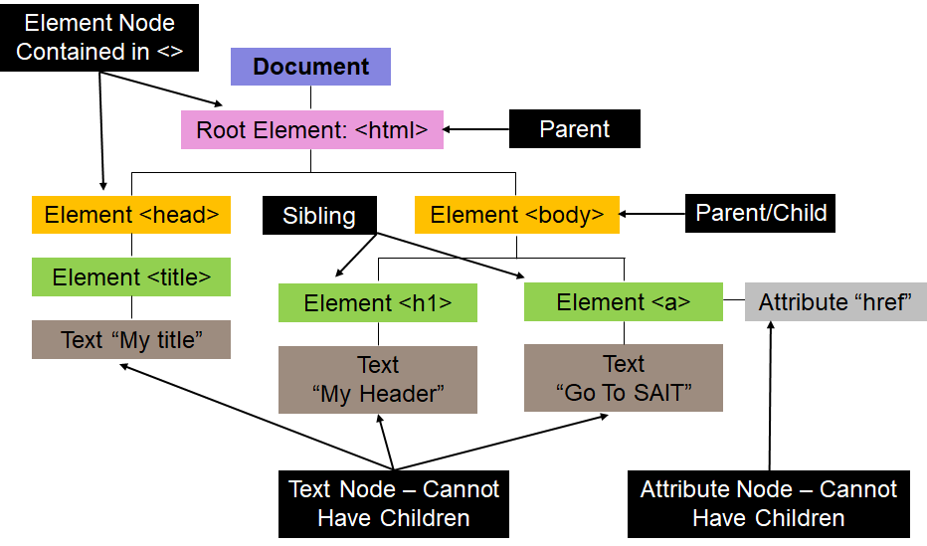
DOM Navigation
http://www.w3schools.com/jsref/dom_obj_document.asp
http://www.w3schools.com/jsref/dom_obj_all.asp
The browser generates DOM when it loads web pages
DOM: Object-based model in which objects are organized in a hierarchal tree structure.
Each object in DOM is a node object
Notes:
Object is a container for data and the logic that is needed to maintain the data.
Objects correspond to actual things that people use in their work.
Methods correspond to actual tasks that are done to store and maintain data used in the work.

Slide 21
DOM Navigation
Different Types of Nodes
Document | Top-Level Node
Element | Represents HTML Tags Could have child nodes Child could be element, text, comment nodes Child nodes have parent, siblings, and child Element could have attributes
Methods for Retrieving Nodes Related to Current Node
childNodes() | childElementCount() | nextSibling() | getAttribute()
nodeType() | parentElement() | previousSibling() | nodeName()
Notes:
Object is a container for data and the logic that is needed to maintain the data.
Objects correspond to actual things that people use in their work.
Methods correspond to actual tasks that are done to store and maintain data used in the work.

Slide 22
DOM Navigation
Methods for Inserting & Manipulating Nodes Related to Current Node
appendChild() | removeChild() | insertBefore() | replaceChild()
Methods for Inserting & Manipulating Attributes Related to Current Node
getAttribute() | setAttribute() | attributes() | removeAttribute()
Notes:
Object is a container for data and the logic that is needed to maintain the data.
Objects correspond to actual things that people use in their work.
Methods correspond to actual tasks that are done to store and maintain data used in the work.

Slide 23
Introduction to Bootstrap
Free, Open-Source, Front-End Framework
Faster and Easier Web Development
Includes HTML & CSS Based Design Templates (e.g., Components)
Used to Easily Create Responsive Websites
Why Use Bootstrap?
Easy to use | Supported by all browsers | Facilitate responsive design
http://getbootstrap.com/getting-started/
http://www.w3schools.com/bootstrap/
Notes:
Advantages of Bootstrap:
Easy to use: Anybody with just basic knowledge of HTML and CSS can start using Bootstrap
Responsive features: Bootstrap's responsive CSS adjusts to phones, tablets, and desktops
Mobile-first approach: In Bootstrap, mobile-first styles are part of the core framework
Browser compatibility: Bootstrap 4 is compatible with all modern browsers (Chrome, Firefox, Internet Explorer 10+, Safari, and Opera)

Slide 24
Bootstrap Grid System
It Allows up to 12 Columns
1 | 2 | 3 | 4 | 5 | 6 | 7 | 8 | 9 | 10 | 11 | 12
col-2 |  | col-2 |  | col-2 |  | col-2 |  | col-2 |  | col-2
col-3 |  |  | col-3 |  |  | col-3 |  |  | col-3
col-4 |  |  |  | col-4 |  |  |  | col-4
col-6 |  |  |  |  |  | col-6
col-3 |  |  | col-9
col-12
Grid system is used to create variety of page layout that best fit with mobile devices, tablets, laptops, and desktops.
Layouts are created through rows and columns that house page content
Notes:
Advantages of Bootstrap:
Easy to use: Anybody with just basic knowledge of HTML and CSS can start using Bootstrap
Responsive features: Bootstrap's responsive CSS adjusts to phones, tablets, and desktops
Mobile-first approach: In Bootstrap, mobile-first styles are part of the core framework
Browser compatibility: Bootstrap 4 is compatible with all modern browsers (Chrome, Firefox, Internet Explorer 10+, Safari, and Opera)

Slide 25
Bootstrap Grid System
How It Works?
Rows must be placed within a container class for proper alignment & padding.
Use rows to create horizontal groups of columns.
Content should be placed within columns, and only columns may be immediate children of rows.
Predefined grid classes like .row and .col-xs-4 are available for quickly making grid layouts.
Columns create gutters (gaps between column content) via padding. That padding is offset in rows for the first and last column via negative margin on .rows.
Grid columns are created by specifying the number of twelve available columns you wish to span. For example, three equal columns would use three .col-xs-4.
Demo Examples
Notes:
Advantages of Bootstrap:
Easy to use: Anybody with just basic knowledge of HTML and CSS can start using Bootstrap
Responsive features: Bootstrap's responsive CSS adjusts to phones, tablets, and desktops
Mobile-first approach: In Bootstrap, mobile-first styles are part of the core framework
Browser compatibility: Bootstrap 4 is compatible with all modern browsers (Chrome, Firefox, Internet Explorer 10+, Safari, and Opera)

Slide 26
JSON: JavaScript Object Notation
Text-Based Data Interchange Format
Used to Send Data ( as Text) Back & Forth to a Server
Popular Notation for Defining Objects
Written using JavaScript Object Notation
Replace XML and used with AJAX (Asynchronous JavaScript And XML)
http://json.org
Overview
http://www.w3schools.com/json/default.asp
https://developer.mozilla.org/en-US/docs/Web/JavaScript/Reference/Global_Objects/JSON
Notes:
Regular Expression describes/represents a sequence of characters

Slide 27
JSON: Data Types
String: Sequence of Characters Wrapped in “”
Number: Integer or Real
Boolean: true or false
Objects: Wrapped in { }
Arrays: Ordered Key/Value Pairs Wrapped in [ ]
Index.html
Mycode.js
Customer1.json
Customer2.json
Notes:
Regular Expression describes/represents a sequence of characters

Slide 28
Introduction to Testing
Testing: Examination of the behavior of a program by executing the program on sample data sets.
Testing is a verification technique used at the implementation stage.
Goal | Finding faults in the software Demonstrating that there are no faults in the software (for the test cases that has been used during testing)
It is not possible to prove that there are no faults in the software using testing
Testing should help locate errors, not just detect their presence
Notes:
Verification: Demonstration of consistency, completeness, and correctness of the software artifacts at each stage of and between each stage of the software life-cycle.
Different types of verification: manual inspection, testing, formal methods
Verification answers the question: Am I building the product right?

Slide 29
Introduction to Testing
Let P be a program and let D denote its input domain
A test case t is an element of input domain t ∈ D
a test case gives a valuation for all the input variables of the program
A test set T is a finite set of test cases, i.e., a subset of D, T ⊆ D
The basic difficulty in testing is finding a test set that will uncover the faults in the program
Exhaustive testing corresponds to setting T = D
Notes:
Verification: Demonstration of consistency, completeness, and correctness of the software artifacts at each stage of and between each stage of the software life-cycle.
Different types of verification: manual inspection, testing, formal methods
Verification answers the question: Am I building the product right?

Slide 30
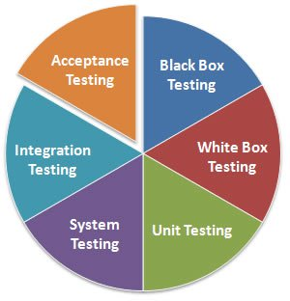
Introduction to Testing
Unit (Module) testing
testing of a single module in an isolated environment
Integration testing
Testing parts of the system by combining the modules
System testing
Testing of the system as a whole after the integration phase
Acceptance testing
Testing the system as a whole to find out if it satisfies the requirements specifications
Notes:
Functional (Black box) vs. Structural (White box) testing
Functional testing: Generating test cases based on the functionality of the software
Structural testing: Generating test cases based on the structure of the program
Black box testing and white box testing are synonyms for functional and structural testing, respectively.

Slide 31
Testing-Driven-Development (TDD)
Design tests before writing code
Automate testing to avoid repeated manual data entry
https://www.tutorialspoint.com/software_testing_dictionary/test_driven_development.htm
https://code.tutsplus.com/tutorials/the-newbies-guide-to-test-driven-development--net-13835
EBook
https://leanpub.com/tdd-ebook/read
Use Java and C# examples. Save this resource for later when you can understand the code
Notes:
Verification: Demonstration of consistency, completeness, and correctness of the software artifacts at each stage of and between each stage of the software life-cycle.
Different types of verification: manual inspection, testing, formal methods
Verification answers the question: Am I building the product right?

Slide 32
Testing-Driven-Development (TDD)
Testing Framework | Description
HTTPUnit | Framework for building test cases for HTML and JavaScript Use Java to build the test cases, so maybe hold back on this until later
JUnit | Java testing framework that will be encounter later
PHPUnit | PHP unit testing framework
PHPUnit Manual and Tutorials
https://phpunit.de/manual/current/en/index.html
https://www.sitepoint.com/getting-started-with-phpunit/
https://www.sitepoint.com/tutorial-introduction-to-unit-testing-in-php-with-phpunit/
http://www.simpletest.org/en/unit_test_documentation.html
Notes:
Verification: Demonstration of consistency, completeness, and correctness of the software artifacts at each stage of and between each stage of the software life-cycle.
Different types of verification: manual inspection, testing, formal methods
Verification answers the question: Am I building the product right?

Slide 33
Exercises
Exercise
Do the exercises in “CPRG210 Exercises Day 7.doc”
These pages may be of interest too
https://developer.mozilla.org/en-US/docs/Web/JavaScript/Guide/Working_with_Objects
https://developer.mozilla.org/en-US/docs/Web/JavaScript/Closures
Notes:
The continue statement will break the current loop and continue with the next value.
When I = 4, the rest of the loop will not be executed and will move to the next iteration (I = 5)

